Slide 1

HOW TEETH WHITENING CHANGED THE LANDSCAPE OF STATE BOARD ACTIONS
Prepared by the Washington State Attorney General’s Office
Last revised: September 2016

Slide 2


North Carolina State Board of Dental Examiners v. Federal Trade Commission
Decided February 25, 2015,
by the United States Supreme Court

Slide 3
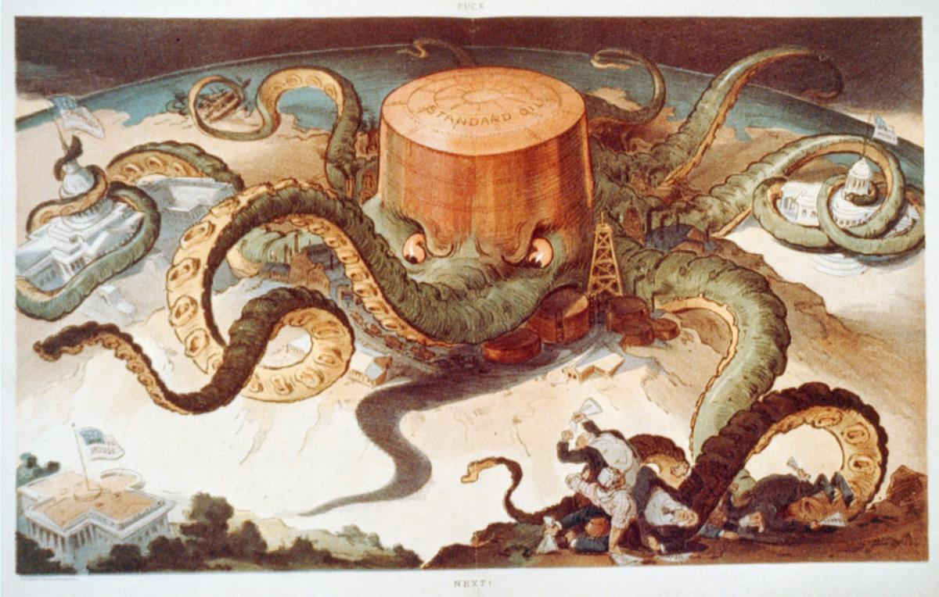
Antitrust Background

Slide 4
Antitrust 101
Purpose: promoting robust competition
Sherman Act prohibits:
  cartels,
  price fixing
  practices that unreasonably restrain trade
The antitrust laws target conduct which unfairly tends to destroy competition itself

Slide 5

Per Se Violations
Certain acts are so harmful to competition that they are almost always illegal

Slide 6
Rule of Reason
Procompetitive Benefits
Anticompetitive Effects
Restraint on Trade

Slide 7
State Action Exemption
Sherman Act vs. state sovereignty
1943 U.S. Supreme Court Parker decision
States allowed to restrain competition to promote other goals valued by citizens
Antitrust lawsuits dismissed

Slide 8
What About State Regulatory and Licensing Boards?
Q: Where a State authorizes regulatory and licensing boards to regulate their own professions, is there antitrust immunity?
A: “Not necessarily,” and especially not where the board is controlled by members of the profession it regulates

Slide 9
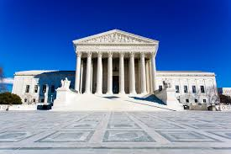
The NC Dental Decision

Slide 10
NC Dental Facts
The North Carolina Board of Dental Examiners
  6 of the 8 members were practicing dentists
  Decided that North Carolina’s dental practice act permitted only dentists to whiten teeth
  Sent 47 cease-and-desist letters to non-dentist teeth whiteners warning them to stop “all activity constituting the practice of dentistry”

Slide 11
NC Dental Procedural History
The FTC sued the dental board for antitrust violations
The Dental Board tried to assert State Action immunity
The FTC countered that
(1) industry participants controlled the board
  (2) no real State involvement in the board’s action

Slide 12
Supreme Court Holding
A state board on which a controlling number of decision-makers are active market participants is exempt from antitrust liability only where it has:
  (1) acted in accordance with a clearly articulated
  state policy to allow the anti-competitive
  conduct; and
  (2) received active state supervision
Motion to dismiss denied

Slide 13
Effect of the Decision
Tougher for boards made up of active market participants to have antitrust lawsuits dismissed early in litigation
But no substantive change to the underlying antitrust law standards

Slide 14
NC Dental Takeaway
When a State empowers a group of active market participants to decide who can participate in its market and on what terms, active state supervision is required for antitrust exemption

Slide 15

Invoking the State Action Exemption After NC Dental

Slide 16
Defining Active Market Participant
A member of the state regulatory board is an “active market participant” where:
(1) the person is licensed by the board OR
(2) provides a service that is subject to the
regulatory authority of the board.

Slide 17
Defining Active Supervision
Review substance of anticompetitive decision and compare to state policy
Power to veto or modify particular decisions of the board to ensure they accord with state policy
Active Supervisor ≠ a market participant

Slide 18
What Is Not Active Supervision?
A state attorney general or other state official providing advice to a board
Approving actions that comply with procedural requirements of the APA
No authority to disapprove anticompetitive acts that fail to accord with state policy
Mere potential for supervision not enough

Slide 19
FTC Guidelines for Active Supervision
The supervisor should:
  Review the record created by the board and supplement if necessary
  De novo review of the substantive merits of the proposed board decision with respect to state policies
  Written decision approving, modifying or vetoing the proposed action

Slide 20
Don’t Forgot About Clear Articulation
The clear articulation standard existed before NC Dental and was not the focus of decision
Anticompetitive conduct must be a foreseeable result of state law authorizing the licensing or regulatory board’s action
Active supervision required to make sure board’s action is consistent with clearly articulated State policy to displace competition

Slide 21
What Does This Mean for Licensing and Regulatory Boards?

Slide 22
Pay Attention to Competitive Effects
Pay attention to possibility of anti-competitive effects when an act, rule, regulation, or policy falls into one or more of the following categories:
  Actions affecting scope of practice;
  Requirements for licensure, especially requirements designed to limit new entrants to the market;
  Price regulations;
  Restrictions on advertising or soliciting of customers; or
  Restrictions on market participation (dealing with non-licensees)

Slide 23
Watch Out!
A regulatory board controlled by dentists excludes non-dentists from competing with dentists to provide teeth-whitening services
A regulatory board controlled by accountants restricts the number of licenses that can be issued to a small and fixed number
A regulatory board controlled by attorneys adopts a regulation that prohibits attorney advertising or deters attorneys from engaging in price competition.

Slide 24
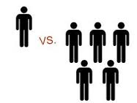
In the clear
Reasonable restraints on competition do not violate the antitrust laws, even where they injure the economic interests of a competitor:
E.g., prohibiting fraudulent business practices
Suspending the license of one competitor in a market with hundreds of service providers
But pay attention to enforcement actions affecting multiple licensees.

Slide 25
Still in the clear
The ministerial (non-discretionary) acts of a regulatory board engaged in good faith implementation of an anticompetitive statutory regime do not give rise to antitrust liability:
  For example, a board may decline to issue a license to an applicant who fails to submit the materials required by the statute.

Slide 26
Still in the clear x 2
The initiation and prosecution of a lawsuit by a regulatory board does not give rise to antitrust liability
  E.g., a lawsuit against a particular individual who is practicing without a license where a state statute authorizes the board to stop an unlicensed person from practicing

Slide 27

Real-World Examples:
Virginia
Chiropractor vs. Medical Board (controlled by medical physicians)
Individual Chiropractor alleged conspiracy to improperly interpret Virginia statutes defining scope of chiropractic care to stifle competition
No State Action exemption because no active supervision
But board won on the merits—disciplinary action taken against single licensee did not harm competition

Slide 28

Real-World Examples: Texas
Allegation: standard of care rules limited competition from telehealth providers
Board members sued in official capacity and as individual market participants (individuals later dismissed)
Trial court denied motion to dismiss: no active supervision
“Clear articulation” element was satisfied since the Texas Medical Practices Act authorizes the medical board to displace competition by regulating telemedicine

Slide 29
Actions, Defense, Costs & Judgment
Stymied competitors vs. board members in their individual capacities
AG defends board members sued in their individual capacity
  if acts or omissions were within the scope of the board member’s official duties, or
  where the board member had a good faith belief that the acts or omissions were within the scope of official duties;

Slide 30
So now what?
Evaluate competitive effects
Avoid anti-competitive actions
Stay within the bounds of the regulatory authority delegated by the legislature
Prepare for a potential increase in antitrust claims in response to board actions
Legislative solution? More active supervision?

Slide 31
Contact Information:
Please contact the Assistant Attorney General for your Board
General questions may be directed to the Antitrust Division:
Justin Wade
Justinw@atg.wa.gov
Jonathan Mark
JonathanM2@atg.wa.gov

